Slide 1

2015-2016 Budget Development Update
March 23, 2015

Slide 2

BCC Email
Legislative Update House Bill 1 & Senate Bill 2
  Full Funding of the Foundation School Program
  No Increase to Basic Allotment - $5,040 for both years
  Austin Yield Increase to $72.94 (FY16) and $76.75 (FY17)
    Approximately +$4m
  Elimination of TRS Rider 7122
    Approximately -$4m
Increases in Funding for FBISD are Fueled by Rising Property Values and Increasing Enrollment

Slide 3
BCC Email
March 2015 Update
Other Major Legislative Areas of Interest
  Improving Early Education
  Tax Relief and Budget Controls
  Instructional Materials Allotment Changes
  TRS Care Insolvency – Possible Increase to District Contribution
  Voucher/Choice Legislation
  Debt / Transparency Legislation
  Fund Balance Transparency – LBB Focus
  Achievement School Districts/Low Performing Campuses

Slide 4

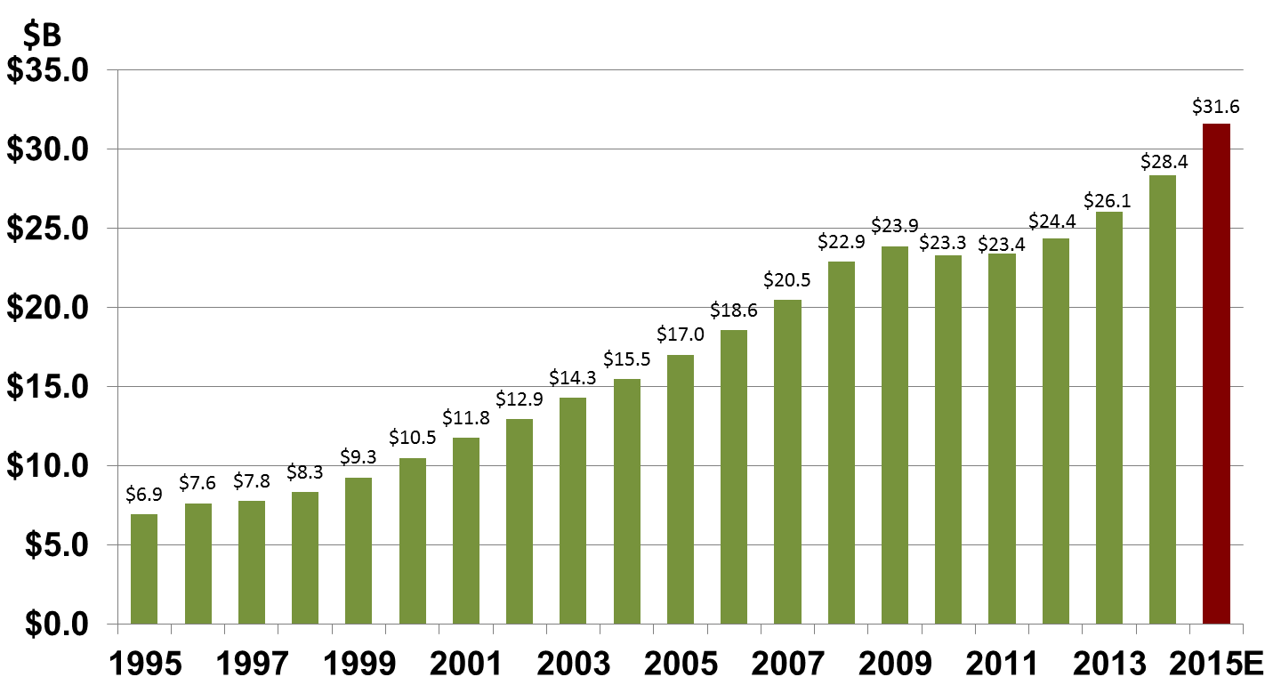
Property Value Growth Update
March 2015 Update
11.5% Local Value Growth
Early Estimate From CAD
Early Estimate From CAD
Source: FBISD CAFR & Central Appraisal District

Slide 5
Property Value Growth Update
March 2015 Update
Early Estimate From CAD
Early Estimate From CAD
Source: FBISD CAFR & Central Appraisal District

Slide 6
Enrollment Growth Update
March 2015 Update
72,317
Projected (0.19% diff)
Source: AEIS/TAPR & PASA Demographic Projections (Most-Likely Scenario as of Feb. 2015)

Slide 7
Position Request Update
2015-16 Campus Formula Position Request Summary
Classification | FTEs | Salary
Teacher Positions | 15.5 | $980,375
Other Campus Professional Positions | 4.5 | $309,777
Campus Paraprofessional Positions | -2 | -$82,260
Total Position Requests | 18 | $1,207,893
Source: FBISD Staffing Guidelines

Slide 8
2015-16 WIP Budget Assumptions Update
Work-In-Progress
Enrollment – 73,377 (PASA February 2015 Most-Likely Growth)
11.5% Property Value Growth (updated Central Appraisal District estimate)
62 Campus Positions (18 formula requested/12 ES#46, 32 CATE approved 2/23/15)
10 Non-Campus Positions (approved 2/23/15)
7.5 Contingency Teaching Positions
Estimated Cost of Salary Increase at 2%
$2.5M added for Transportation (grandfathering & feeder pattern changes)
Legislative Session Decisions
  Elimination of Rider 71 (included)
  Increase Austin Yield ? (Included)
  Increase Basic Allotment ? (Not Included)

Slide 9
2015/16 Budget Development Update
2015-16 Work-in-Progress Projected Estimates
With FY14 Actuals and FY15 Year-End Projections
Source: FBISD Finance
Note: 2014-15 Local Expenses were reduce by $5.9M for Extended Day Moving to Enterprise Fund 711
Remember: Fund Balance ≠ Cash Balance

Slide 10
Critical Dates
March 23 Board Workshop | Review of Campus Formula Staffing and Initial Compensation
March 24 | 2015 FBISD Job Fair and Talent Draft
March 30 Regular Board Meeting | Consider Approval of Additional Campus Staffing Recommendations
April 13 Board Workshop | Budget and Legislative Update; Review Contract Recommendations; Additional Campus Staffing; Initial Discussion on Non-staffing Enhancements; Debt Service Update
Source: FBISD Finance

Slide 11
Critical Dates
April 20 Regular Board Meeting | Consider Approval of Contract Recommendations (Renewals, Non-Renewals, Terminations); Consider Approval of Additional Campus Staffing (Special Education, ESL (English Second Language), Other)
May 11 Board Workshop | Discussion of Additional Staffing, Compensation, Non-Staffing Enhancements; Action to Call Meeting for the Purpose of Discussing the Proposed Tax Rate and Adoption of the 2015/2016 Budget
May 18 Regular Board Meeting | Consider Approval of Additional Staffing, Compensation, Non-Staffing Enhancements; Review Proposed Budget
June 1 Board Workshop | Public Hearing on Budget and Proposed Tax Rate
June 15 Regular Board Meeting | Budget Adoption
Source: FBISD Finance

Slide 12

Do we need this slide???
Questions???
Source: FBISD Finance

Slide 13
Enrollment Growth Update
March 2015 Update
Source: FBISD Finance & PASA Demographic Projections

